Slide 1
Teaching Today’s Learners:
Alternative Assessments & Rubrics
Dr. Dawn Bikowski
Director, English Language Improvement Program
Department of Linguistics
Ohio University, USA

Slide 2
This Session Will Cover
Assessment and motivation
Assessment types overview
Types of alternative assessments
Using alternative assessments effectively
Making and using rubrics
Learner training with alternative assessments

Slide 3
Assessment vs. Testing
Assessment more comprehensive, general
What is included in assessment?
Tests
Observations
Interviews
Projects
Activities with data collection
Notes:
Evaluation: Procedures to determine if a student meets pre-set criteria to qualify for a program or service

Slide 4
Chat
Did you ever take a test that you thought wasn’t fair?
How did that make you feel?

Slide 5
Chat
Did you ever take a test that you thought wasn’t fair?
How did that make you feel?

Slide 6
Chat
How can we use assessment to motivate students?

Slide 7
Assessments and Motivation
Appreciate your students’ hard work
Use assessments to build rapport with students and build their self-esteem
Personalize feedback and assessment when possible; provide specifics
Assess strengths as well as weaknesses
(Fengying, 2003)

Slide 8
Assessments and Motivation
Combine types of assessments
Students can identify strengths and weaknesses
Teachers can collect more comprehensive data
Notes:
Alternative assessment is one part of your assessment toolkit. It fits within a larger assessment and educational context.

Slide 9
Assessments and Motivation
6. Use Objectives-Referenced Assessment
Assessments and grades based on lesson objectives
Precise grading and comments
Students less likely to question grading
Students evaluate their own learning

Slide 10
Why Assessment?
http://comicskingdom.com/tiger/

Slide 11
Why Assessment?
To give grades
http://comicskingdom.com/tiger/

Slide 12
Why Assessment?
To give grades
To plan instruction
To improve instruction and programs
To help students learn
http://comicskingdom.com/tiger/

Slide 13
II. Overview of Assessment types

Slide 14
Formal Assessment
Systematic way to evaluate students’ progress & overall achievement
Standardized measures
Often tests for class grades
Benchmark tests
How well students perform compared to peers
Performance beginning, middle, end of term
Measures what we know about language

Slide 15
Formal Assessment Example
s
http://englishteststore.net

Slide 16
Types of Assessment Matching
A.
Formal evaluation at the end of a learning period. Purpose: to measure what a student learned.
Formative ______
Peer ______
Summative _____
B.
Assessment that takes place during the process of learning. Purpose: to provide feedback to help the learning process.
C.
Learners evaluate each other’s work, using pre-set guidelines

Slide 17
Types of Assessment Matching
A.
Evaluation at the end of a learning period. Purpose: to measure what a student learned.
Formative __B___
Peer __C___
Summative __A__
B.
Assessment that takes place during the process of learning. Purpose: to provide feedback to help the learning process.
C.
Learners evaluate each other’s work, using pre-set guidelines

Slide 18
Summative
Evaluation at the end of a learning period. Purpose: to measure what a student has learned.
Formative
Assessment that takes place during the process of learning. Purpose: to provide feedback to help the learning process.
Peer Assessment
Learners evaluate each other’s work, using pre-set guidelines. Purpose: Learner development.

Slide 19
Alternative Assessment
“Procedures and techniques which can be used within the context of instruction and can be easily incorporated into the daily activities of the school or classroom.”
(Hamayan, 1995, p. 213)

Slide 20
Which words match?
“Students are evaluated on what they (a)___________ and (b) ____________
rather than on what they are able to
(c) ____________ and (d) _____________”
Word Bank:
reproduce, integrate, produce, recall

Slide 21
Which words match?
“Students are evaluated on what they (a) integrate and (b) produce rather than on what they are able to (c) recall and (d) reproduce”
(Huerta-Macias, 1995, p. 9)

Slide 22
Alternative Assessment
Performance based; focus on use of language
Designed and structured differently from formal
Graded or scored differently from formal
Based on authentic tasks

Slide 23
Alternative Assessment
Performance based
Designed and structured differently from formal
Graded or scored differently from formal
Based on authentic tasks
Goal is to evaluate how well learners can communicate in various ways

Slide 24
Alternative Assessment
Performance based
Designed and structured differently from formal
Graded or scored differently from formal
Based on authentic tasks
Goal is to evaluate how well learners can communicate in various ways
Learners involved in assessment process
Help to set the criteria
Can assess themselves and their peers

Slide 25
Which of the following is NOT a characteristic of Alternative Assessment?
They are built around topics or issues of interest to the students
They are based on real-world communication contexts and situations
They require creative use of language rather than simple repetition
They allow for only one correct answer or right way
Their evaluation criteria and standards are known to the student
They allow for self-evaluation and self-correction as they proceed
Notes:
Correct answer: D is NOT a characteristic of alternative assessment

Slide 26
Gather evidence about how students complete real-world tasks:
Document individual student growth over time, not comparing students
Emphasize students’ strengths, not weaknesses
Consider context issues such as:
Learning styles, cultural/educational backgrounds
Language proficiency, grade level
Course content

Slide 27
Chat
I want to try alternative assessments, but where will I find the time?
I have too many tests to give…. Help!
Question:
Where can we fit alternative assessments?

Slide 28
Alternative assessment and curriculum
Where can we fit alternative assessments?
Formative assessments:
To guide teaching topics and lessons
To prepare for formal assessments/standardized tests
Activities:
Many activities can become alternative assessments

Slide 29
Activities vs. Assessment
Many class activities can become assessment if you:
1. Keep good records
2. Are clear with yourself (and your students) about the criteria for what is being assessed

Slide 30
Activity with Criteria & Weighting
Assignment:
Record yourself speaking on ______ topic for 2-3 minutes
You will be graded on your word stress:
Correct number of syllables (0-25 points)
Correct syllables stressed (0-25 points)
Unstressed syllables have reduced vowels (0-25 points)
Variation in syllable length (0-25 points)

Slide 31
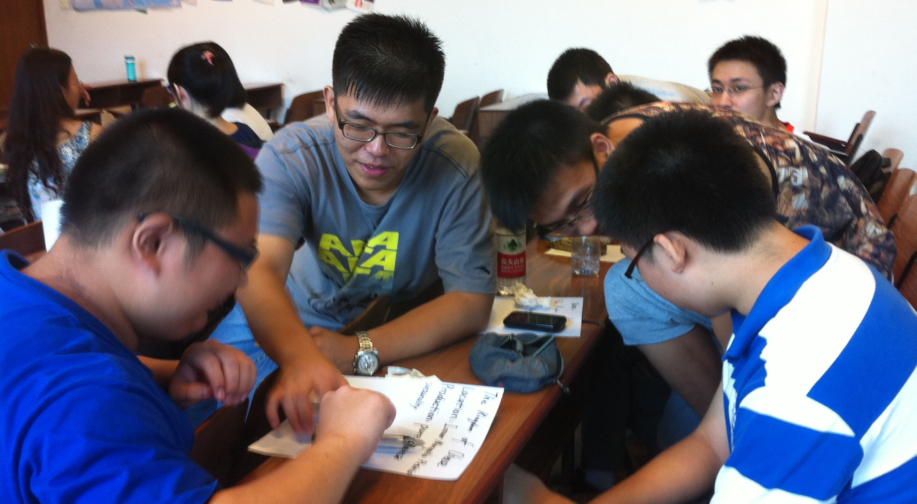
Building a Class Community

Slide 32
How can we provide a supportive classroom atmosphere so students feel comfortable with self-assessment, peer assessment, sharing their work?
Tell students your class and activity goals
Give supportive and helpful feedback
Allow students to make some choices in class
Try to trick students to show them what they don’t know—NO
Choose activities that are motivating for students
Teach students how to set and monitor goals
Include community-building activities for class

Slide 33
IIi. Types of alternative assessments

Slide 34
Section overview
Student self-assessment
Peer review
Speaking and presenting assessments
Reading and writing assessments
Portfolios

Slide 35
Student Self Assessment
Students set goals based on curriculum

Slide 36
Student Self Assessment
Sample Goals:
Use the present tense correctly when speaking about general truths.
Speak loudly and have good eye contact during presentations.
Use topic sentences to begin paragraphs in academic writing.
Students set goals based on curriculum

Slide 37
Student Self Assessment
Feedback and assessment will be specific
Will not be comprehensive
Purpose: to help students attain goals
Students set goals based on curriculum
Teacher assessments focus on goal areas

Slide 38
Student Self Assessment
Students may need to be trained to be self-directed learners
Teachers can give students feedback on their self-assessments
Students set goals based on curriculum
Teacher assessments focus on goal areas
Student self-assessments focus on goal areas

Slide 39
Student Self Assessment
Learning logs
Conferences
Writing
Students set goals based on curriculum
Teacher assessments focus on goal areas
Student self-assessments focus on goal areas

Slide 40
Student Self Assessment
Learning logs
Conferences
Writing
Students set goals based on curriculum
Teacher assessments focus on goal areas
Student self-assessments focus on goal areas
Students reflect on progress
Journals (in- or out-of-class): Penzu, Google Docs
Pair share with partner
Class presentations

Slide 41
Student Self Assessment
Learning logs
Conferences
Writing
Students set goals based on curriculum
Teacher assessments focus on goal areas
Student self-assessments focus on goal areas
Students reflect on progress
All assessments are based on criteria

Slide 42
Samples: Self-Assessment Techniques
What types of assignments are good for self-assessments?
What can students record?
Where can students put this information?
Notes:
2. What example of assignment guidelines did you see? For what kind of assignment were the
criteria written?

Slide 43
Samples: Self-Assessment Techniques
What types of assignments are good for self-assessments?
Assignments where they can keep a checklist based on specific guidelines & criteria, for any skill
Show progress over time
What can students record?
Activities, time spent, progress toward goals
Where can students put this information?
Charts, logs, journals, binders, Google Docs/Forms

Slide 44
Sample Self-Assessment Chart
http://www.americanenglish.state.gov/resources/shaping-way-we-teach-english-successful-practices-around-world
Notes:
2. What example of assignment guidelines did you see? For what kind of assignment were the
criteria written?

Slide 45
Sample learner log

Slide 46
Sample learner log

Slide 47
Sample learner log

Slide 48
Sample learner log

Slide 49
K-W-L Charts
K: what I know
W: what I want to know/find out
L: what I've learned
Chart can be completed in 1st language or with illustrations
Know | Want to know | Learned

Slide 50
Chat
How can we use KWL charts to help learners with reading?

Slide 51
http://vimeo.com/82798767

Slide 52
Self-Assessment Feedback
Why give self-assessment feedback?
How much should teachers talk? How much should students talk?

Slide 53
Self-Assessment Feedback
Why give students self-assessment feedback?
Help them stay on goals & monitor progress
Help them set new goals as needed
Help them celebrate successes

Slide 54
Self-Assessment Feedback
Why give students self-assessment feedback?
Help them stay on goals & monitor progress
Help them set new goals as needed
Help them celebrate successes
How much should teachers talk? How much should students talk?
Students should talk more than the teacher; teacher is a guide

Slide 55
Steps in Doing Self-Assessment
Identify task that students should monitor in own learning
Identify criteria students will need to complete the task successfully
Make or find a form they can complete—give them a sample
Require the self-assessment form for grade

Slide 56
Peer Review
http://www.americanenglish.state.gov/resources/shaping-way-we-teach-english-successful-practices-around-world

Slide 57
Poll Questions about Peer Review

Slide 58
Poll Peer Review
Have you ever tried peer review in your classes?
Yes
No

Slide 59
Peer Review Poll
If you have done peer review in your classes, what did you like about it?
Students can help each other
Students can share ideas and build classroom community
Students can think critically
Students can practice listening and speaking
Students can be engaged during class

Slide 60
Peer Review/Feedback Activities
Students in pairs can
Help each other understand the assignment
Share ideas for content and organization or language use
Read each other’s work, giving feedback on the ideas, structure, and clarity of the writing
Listen to each other’s practice presentations
Pairs need clear review guidelines

Slide 61
Peer Review Guidelines
Grouping options
Higher proficiency can help lower proficiency
Equal proficiency students work together
Teacher roles
Facilitators to help students give useful feedback
Time keepers & resource experts
Student roles
Active participants, thinking critically, talking, listening

Slide 62
Sample peer review form

Slide 63
Examples
Self-Assessment & Peer Review
Speaking & Presenting

Slide 64
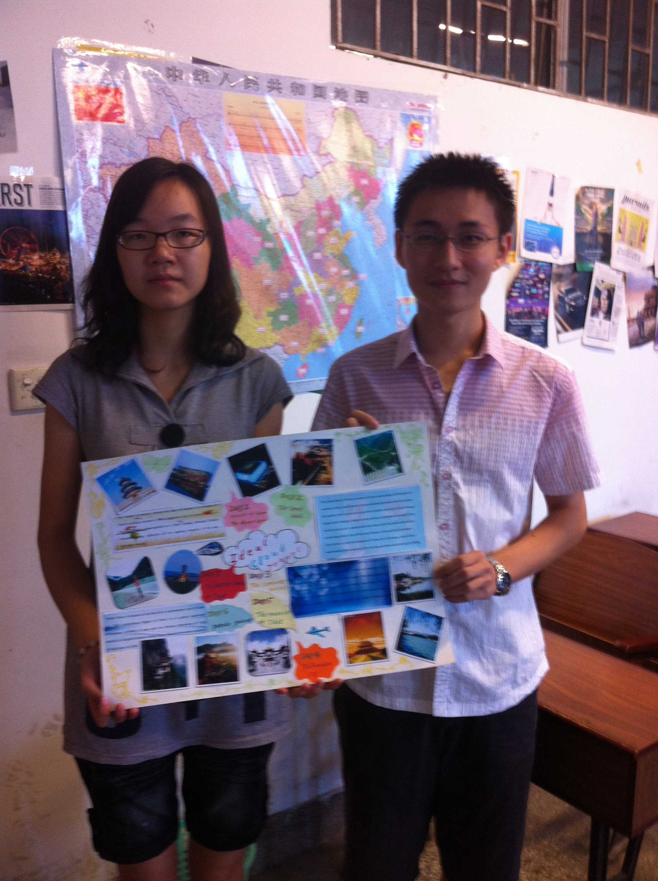
What type of alternative assessment?
Group Project and Poster Presentation
Groups created a travel itinerary for week-long trip in China (budget $1000)
Found hotels, transportation, activities
Created poster
Practiced presenting and asking/answering questions
Presented poster in Open Format

